Slide 1

Intern Progress Tracker System
Optimizing Intern Performance with Real-Time Insights
Team Members:
Aditya V
V Pratheek
Shriansh Kulkarni
Saili Patil
Rohan Kanegaonkar
Organization: FNF India

Slide 2



Executive Summary
The Challenge
Traditional Internship Programs struggle with Manual Tracking, Scattered Communication, and Limited Visibility Into Intern Performance. Administrative Teams Spend Excessive Time Managing Spreadsheets and Paperwork instead of Focusing on Mentorship and Development, leading to inefficiency, inconsistent reporting, and low engagement.
Our Solution
A comprehensive digital platform that streamlines and automates the entire internship lifecycle from task assignment and progress tracking to performance evaluation delivering real-time insights, transparency, and collaboration for all stakeholders.

Slide 3


Stakeholder Ecosystem
Primary Stakeholders
Interns, Trainers, Managers, Admin
Secondary Stakeholders
HR Department, Project Mentors, IT Support Team, Academic/Partner Institutions
Tertiary Stakeholders
Company Management/Executives, Future Interns, Clients or Partner Organizations, Third Party Integration Platforms(GitHub, MS Teams, etc.)

Slide 4
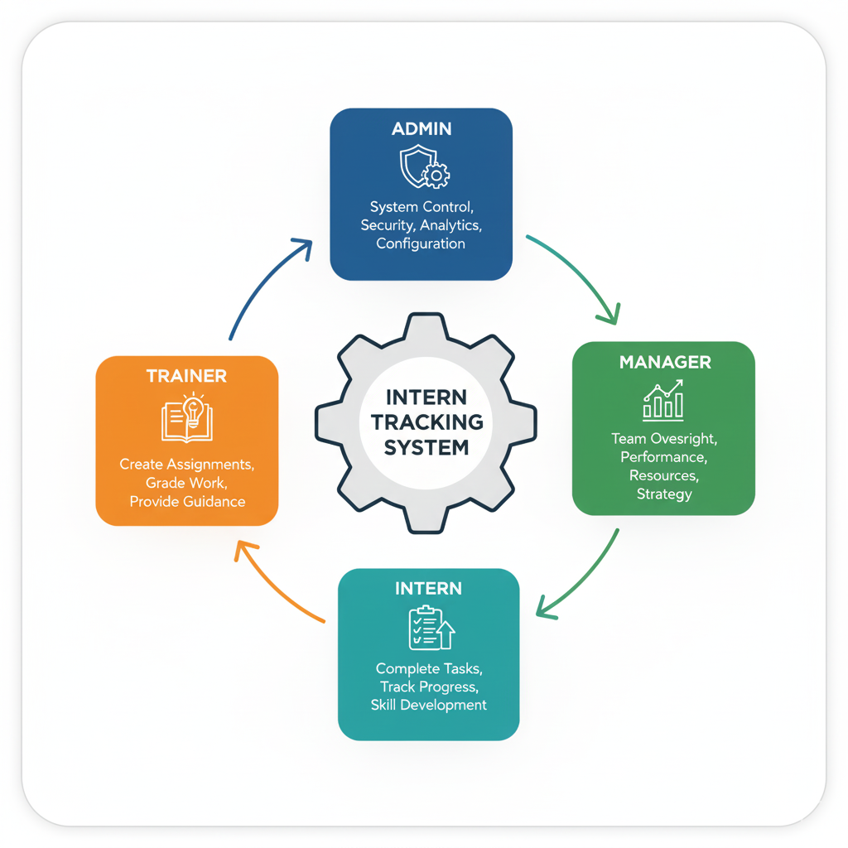





User Roles & Hierarchy
Intern
Task completion, quiz submissions, progress tracking, skill development.
Trainer
Assignment creation, mentorship provision, performance grading, and direct intern guidance.
Manager
Team oversight, performance analytics, resource allocation, and strategic program decisions.
Administrator
System-wide control, Perform CRUD operations, Role Based Filtering And Hierarchy

Slide 5
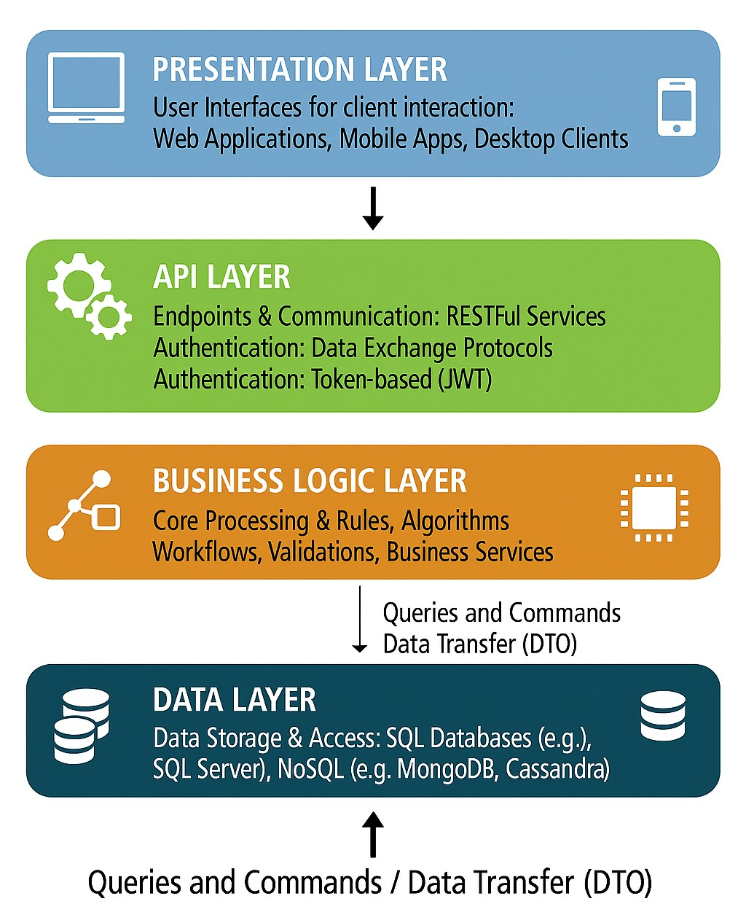







System Architecture Design
Our four-layer architecture ensures scalability, maintainability, and clear separation of concerns throughout the application.
Presentation Layer
React components, user interface, responsive design, and interactive dashboards
API Layer
RESTful controllers, request handling, authentication, and authorization
Business Logic
Service layer, business rules, validation, and workflow orchestration
Data Layer
Entity Framework, SQL Server, data models, and repository patterns

Slide 6
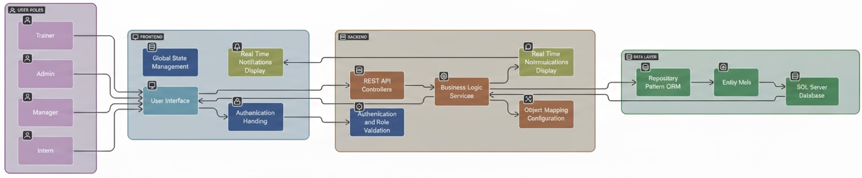


Workflow Diagram

Slide 7




Core Platform Features
Intelligent Task Management | Quiz & Assessment Engine | Real-Time Analytics | Collaboration Hub
A smart assignment management system that enables trainers to create and assign tasks efficiently. It includes automated deadline tracking, real-time progress monitoring, instant notifications, and structured submission workflows streamlining the entire assignment lifecycle from creation to evaluation. | An advanced quiz management system featuring auto-grading functionality, instant feedback delivery, and detailed analytics dashboards. It enables trainers to evaluate intern performance efficiently while providing comprehensive performance tracking to measure learning outcomes and skill development effectively. | A powerful analytics module offering predictive insights, customizable reports, and interactive data visualizations. It tracks performance trends and engagement metrics, empowering administrators and trainers to make data-driven decisions that enhance productivity and program outcomes. | Real-time notifications, a gamified leaderboard system, integrated messaging, and collaborative communication channels that enhance engagement, encourage teamwork, and promote healthy competition among interns.

Slide 8
Unique Features
Role-Based User Authentication:
Secure login system implemented with JSON Web Tokens (JWT), ensuring that each user (Intern, Trainer, or Manager) can access only their designated features and permissions.
Quiz File Parsing and Auto-Conversion:
Supports .xlsx, .xml, and .csv file formats for bulk quiz uploads. The system automatically converts uploaded data into structured multiple-choice question papers, reducing manual effort.
Randomized Question and Option Order:
Each intern receives a unique version of the quiz with randomized questions and shuffled options, preventing cheating and maintaining fairness during assessments.
Real-Time Notifications System:
Interns receive dashboard notifications when trainers assign new tasks or quizzes. Trainers are notified instantly when interns submit completed tasks or quizzes, improving communication efficiency.
Automated Quiz Evaluation:
Quizzes are auto-graded upon submission, providing instant results and saving trainers valuable time in manual scoring.
Leaderboards and Analytics Dashboard:
Interactive leaderboards display rankings for interns, trainers, and managers. The analytics module provides real-time insights using graphs and charts for performance tracking and progress monitoring.

Slide 9







Technology Stack
Frontend Layer
The user interface that powers our application, ensuring a smooth and responsive experience.
Backend Services
Robust and scalable services that handle data processing, business logic, and API interactions.
Data Layer
Secure and efficient data storage and retrieval, designed for performance and integrity.
Supporting Tools
Essential utilities and integrations that enhance development, documentation, and collaboration.
Frontend
Backend
Database
Tools
React 19.1.1
.NET Core 8.0
SQL Server
AutoMapper
TypeScript
Entity Framework
Relational Design
Swagger
Bootstrap 5.3.8
JWT Auth
GitHub Integration
Chart.js

Slide 10









Team Role And Module Division

Slide 11
Team Member | Major Responsibilities
Rohan Kanegaonkar | Admin Management Module Schema Designing Implementation CRUD operations on Users Designing of Dashboard for all roles Randomization of Quiz for each intern
V Pratheek | Role Based Login Module Role Based Access and Login Integration of JWT and Password Hashing Score Submission Implementation Radar Graphs Visualization
Aditya V | Quiz Management Module Upload Excel, CSV, XML for File Parsing and Storing in DB CRUD operations on Quiz Assigning Quiz to interns My Quiz Section in Interns
Shriansh Kulkarni | Task and Notification Module CRUD Operations of Task Assigning of Task Task Submissions in Interns Notifications Implementation across Trainer and Intern
Saili Patil | Analytics and Leaderboard Module Leaderboard Logic Implementation Analytics Logic Implementation Dynamic Score Aggregation Individual Performance Analytics

Slide 12









Major Challenges Faced
Role-Based Access Control
Implemented JWT authentication with granular RBAC permissions, ensuring secure, stateless authorization across all user roles.
Quiz File Parsing
Quiz file parsing faces challenges with inconsistent formats, missing fields, and encoding issues that cause upload failures, leading to user errors and rejected imports.
Data Consistency
Applied Entity Framework relational mapping with foreign key constraints and integrity checks to maintain data reliability.
Analytics And Leaderboard
Key challenges include ensuring accurate, real-time data processing and maintaining clear visualizations
Notification
Key challenges include ensuring accurate, real-time Notification across Trainer and Intern.

Slide 13






Security Features Implemented:
Authentication
Access Control
JWT-based stateless authentication with secure token generation, expiration management, and refresh token support for seamless user sessions.
Granular role-based permissions ensuring users access only authorized resources, with comprehensive audit logging for compliance tracking.
Validation
Testing
Dual-layer validation with client-side checks for user experience and server-side enforcement for data integrity and security.
Comprehensive test suite including manual tests for all layer and performance validation

Slide 14


Future Enhancements
01.Secure Exam Experience
Implement full screen quiz mode with exit warnings (2-step confirmation) to mimic standardized exam environments.
02. Real-Time Notifications
Use SMTP for email alerts and AWS SNS for secure, scalable push notifications.
03. Cloud Hosting
Deploy the platform on Azure for high availability, load balancing, and global reach.
04. Code Quality & Assessment
Integrate static code analyzers for submissions.
Add online judge system for coding challenges, leveraging open-source judges or APIs like HackerRank/CodeRunner.
05. AI & Analytics
Continue with AI-driven insights for personalized learning and predictive analytics.

Slide 15






